Slide 1
Civic Involvement: Your Community, Your Choice
John A. Duerk, Ph.D.
History and Political Science Department
Lake Tahoe Community College
October 19, 2021

Slide 2
Objectives
Explain the concept of social capital as it relates to community building.
Identify some of the ways that power manifests in our lives.
Contrast the more political and less political forms of volunteer work.
Explore some concrete examples of work that can be modeled.

Slide 3
Question:
If you discovered a serious problem in your community, what would you do about it?

Slide 4
Social Capital
Social Capital…
…refers to connections among individuals—social networks and the norms of reciprocity and trustworthiness that arise from them
Trustworthiness lubricates social life
Frequent interaction among a diverse set of people tends to produce a norm of generalized reciprocity
…has both an individual and a collective aspect—a private and a public face
…that is, social networks and the associated norms of reciprocity—come in many different shapes and sizes with many different uses (e.g., extended family, civic organizations)
(Putnam, 2000)

Slide 5
Civic Associations
By the end of the nineteenth century America was rapidly becoming a nation of cities teeming with immigrants toiling in factories operated by industrial combines
Sense of crisis, coupled with inspired grassroots and national leadership, produced an extraordinary burst of social inventiveness and political reform
Civic entrepreneurs built a “club movement” across the land → unmatched in terms of numbers; range (e.g., religious organizations, charitable groups, unions, neighborhood associations, book clubs)
Wave had begun in small towns of the heartland, not in the cosmopolitan metropolis
Americans no longer spend much time in community organizations → we’ve stopped doing committee work, serving as officers, and going to meetings
(Putnam and Garrett, 2020)

Slide 6
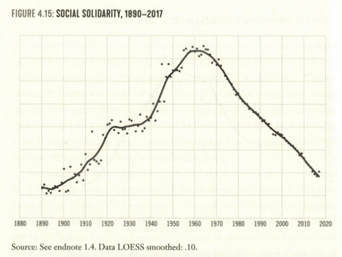
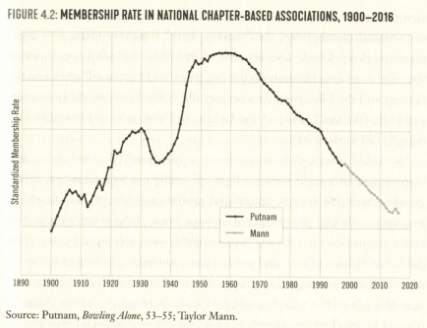
(Putnam & Garrett, 2020)

Slide 7
Power is About Making
a Difference in the World
Principle 1
Power is about altering the states of others
Principle 2
Power is part of every relationship and interaction
Principle 3
Power is found in everyday actions
Principle 4
Power comes from empowering others in social networks
(Keltner, 2016)

Slide 8
Choose
an Issue
Find an Organization
Examine its Work: Issue(s), Goals, Strategies, and Tactics
Your
Motives
Less political activity, i.e., potential for conflict lower
Volunteer
More political activity, i.e., potential for conflict higher

Slide 9
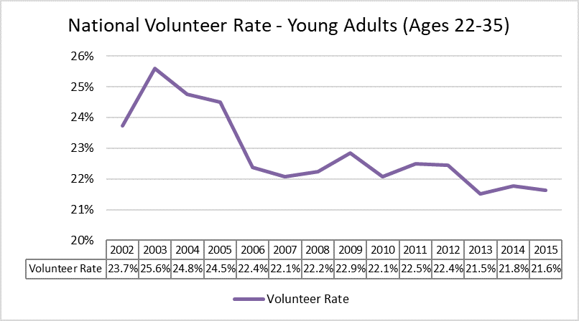
Source: Independent Sector

Slide 10
MORE POLITICAL

Slide 11
Examples of Political Action
Cast a ballot in all elections, including the state and local races
Volunteer on a political campaign during election season
Run for an elected office at any level of government
Join an advocacy group that works on an issue you care about
Write a letter to elected officials who serve in government
Attend a protest (including rallies), demonstration, or march
Speak at city and county meetings
Organize a teach-in or forum to educate community members

Slide 12
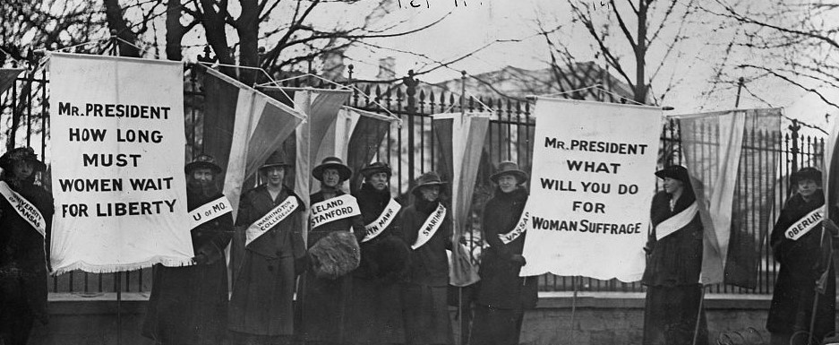
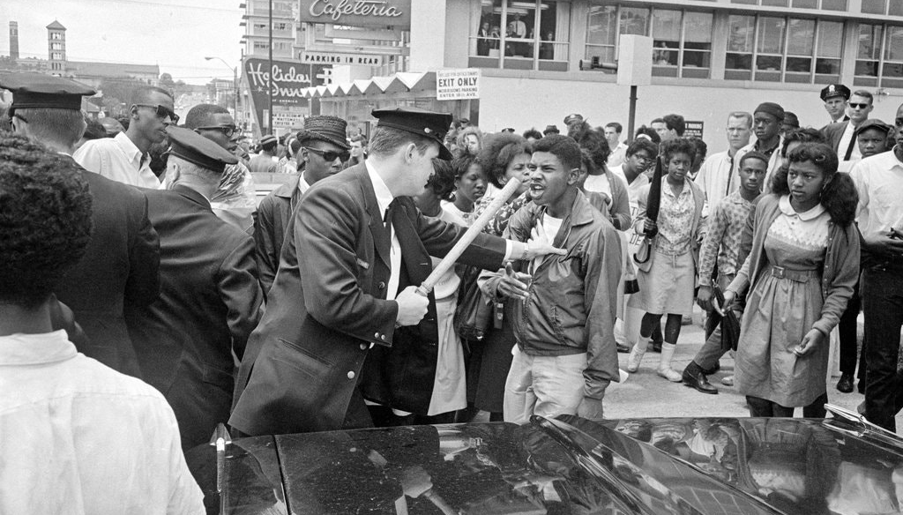
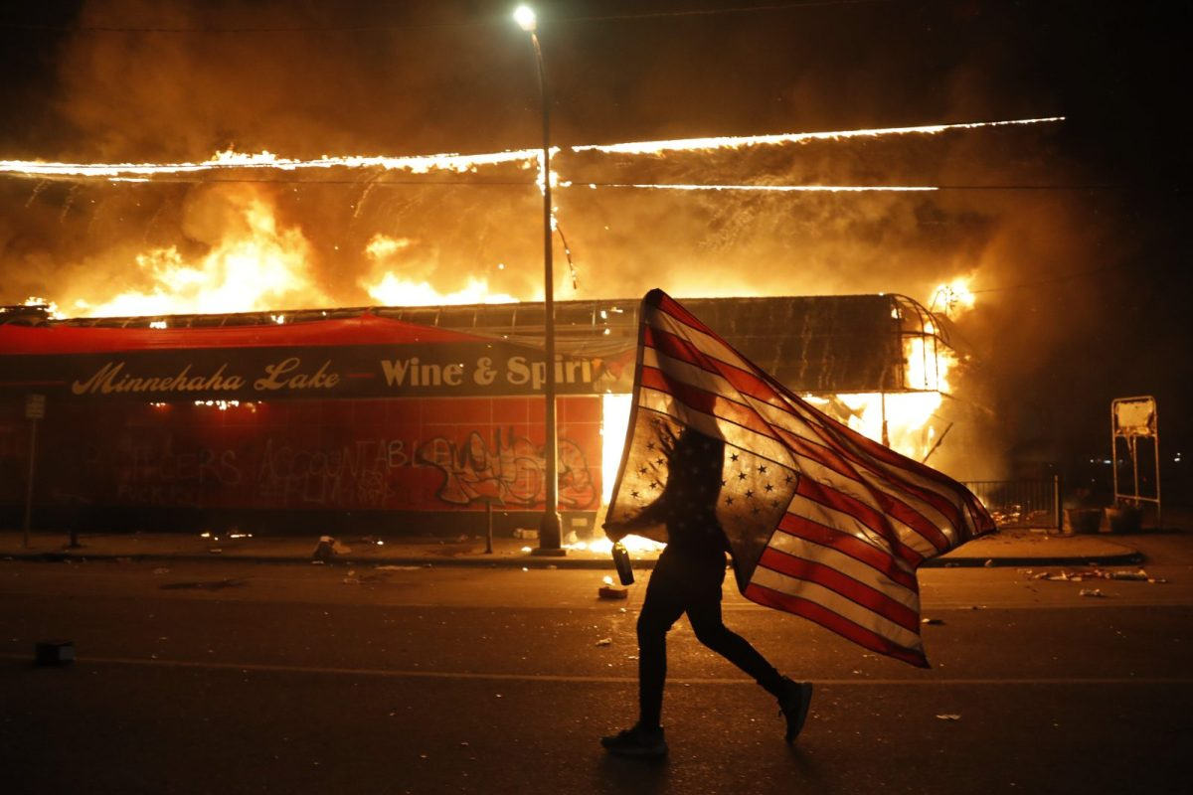
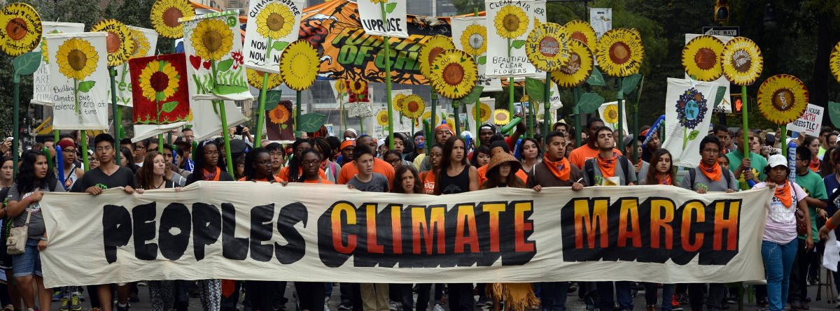
Source: National Women’s History Museum
Source: New York Times
Source: Grist
Source: U.S. News & World Report

Slide 13
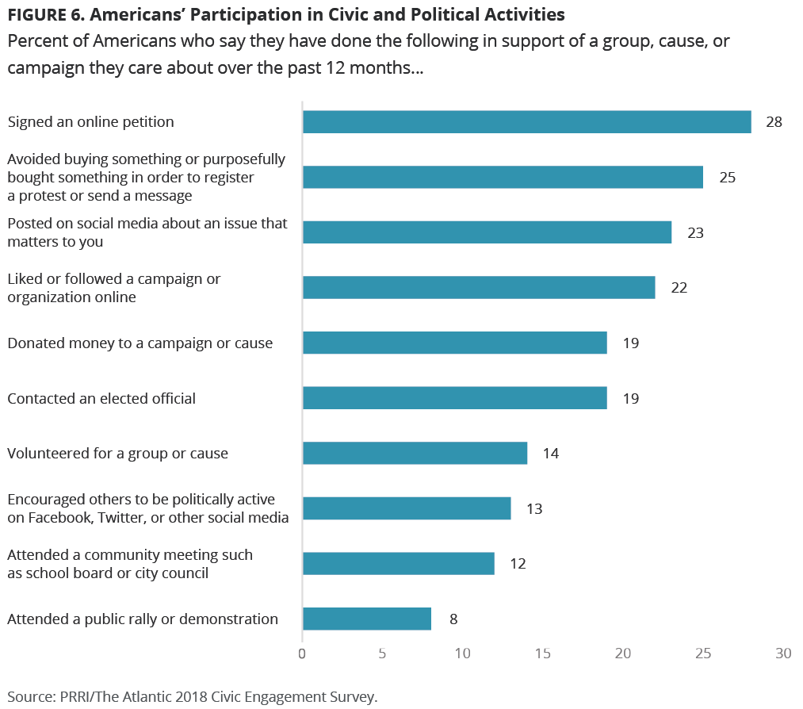
Participation by the Numbers
Source: PRRI

Slide 14
LESS POLITICAL

Slide 15
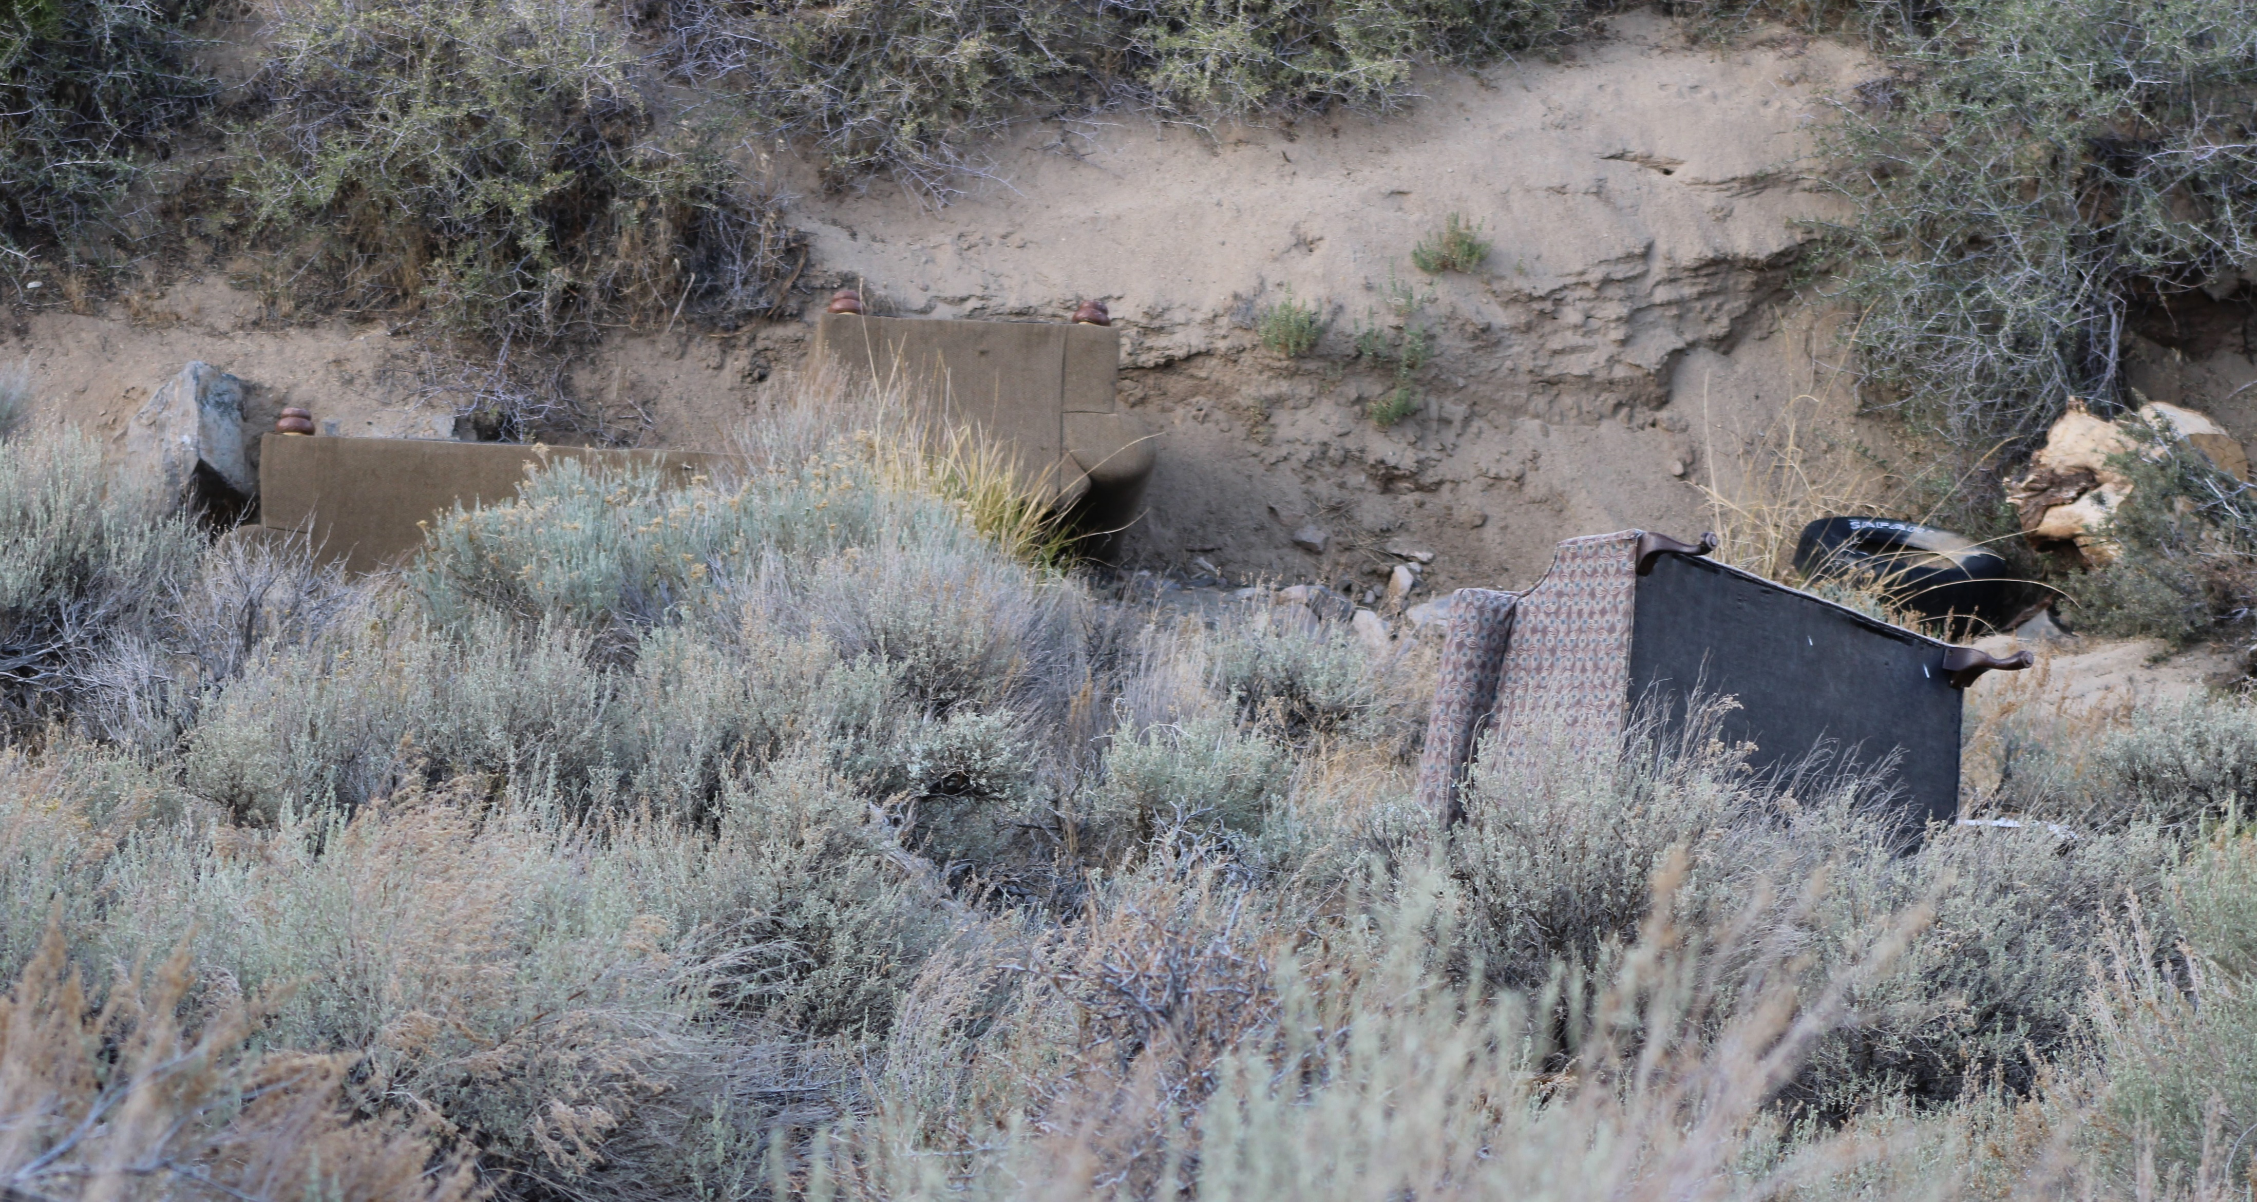
Illegal Dumping
Photo: John A. Duerk

Slide 16
Action Steps
Consulted a map to see which city ward the site falls in
Emailed a letter with pictures to the ward supervisor
Traded additional emails with the ward supervisor and city manager
Filed a report, including pictures, with the city through its website
Purchased a plastic tote and work gloves from a local hardware store to carry in my vehicle
Wrote a letter to the editor of the Nevada Appeal

Slide 17
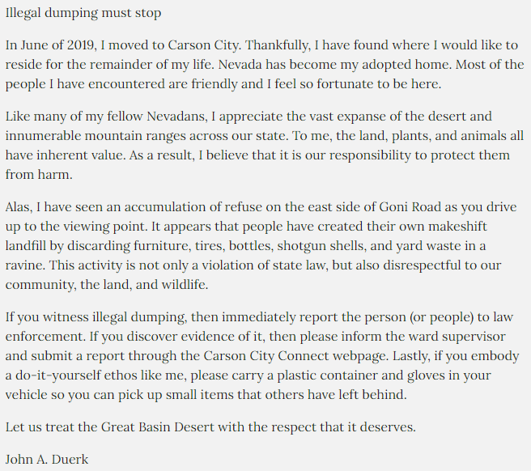
Letter to
the Editor
Published in the Nevada Appeal on August 1, 2020, p. A16

Slide 18
Action Steps (Continued)
Visited the site to collect various smaller items
Spoke with the Public Works and Code Enforcement departments and they determined site is on federal land
Emailed the Bureau of Land Management District Office in Carson City
Spoke with BLM representative and ranger about organizing a volunteer clean-up on a Saturday
Connected with a local non-profit organization, Desert Pigs, and together we have cleared much of the ravine

Slide 19
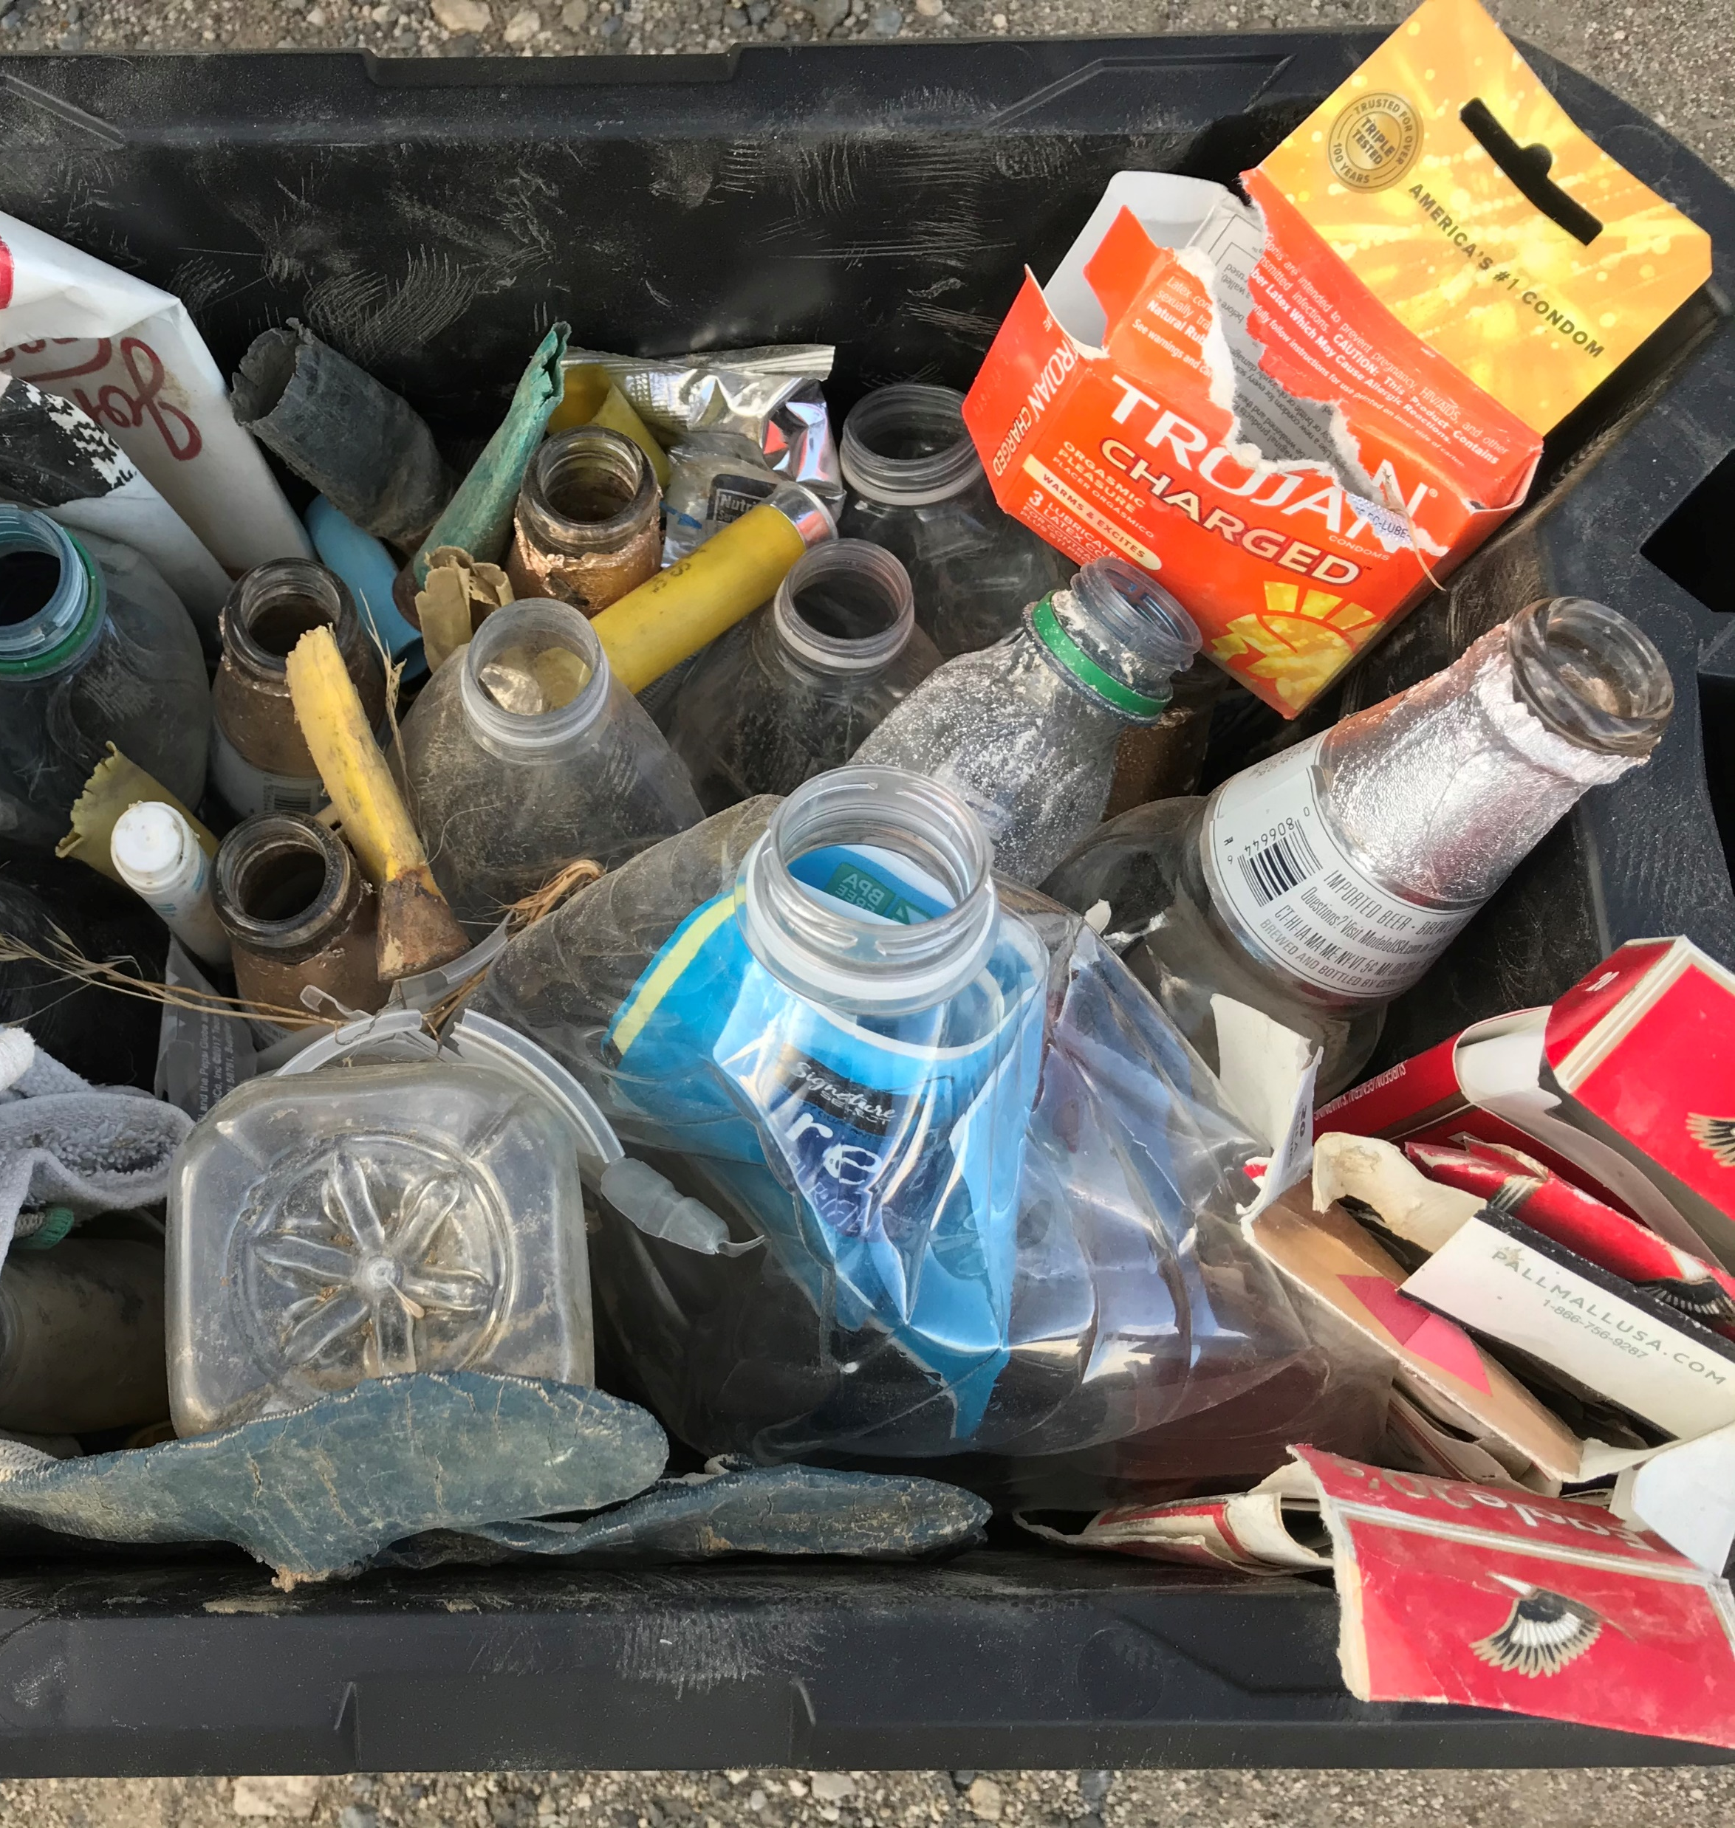
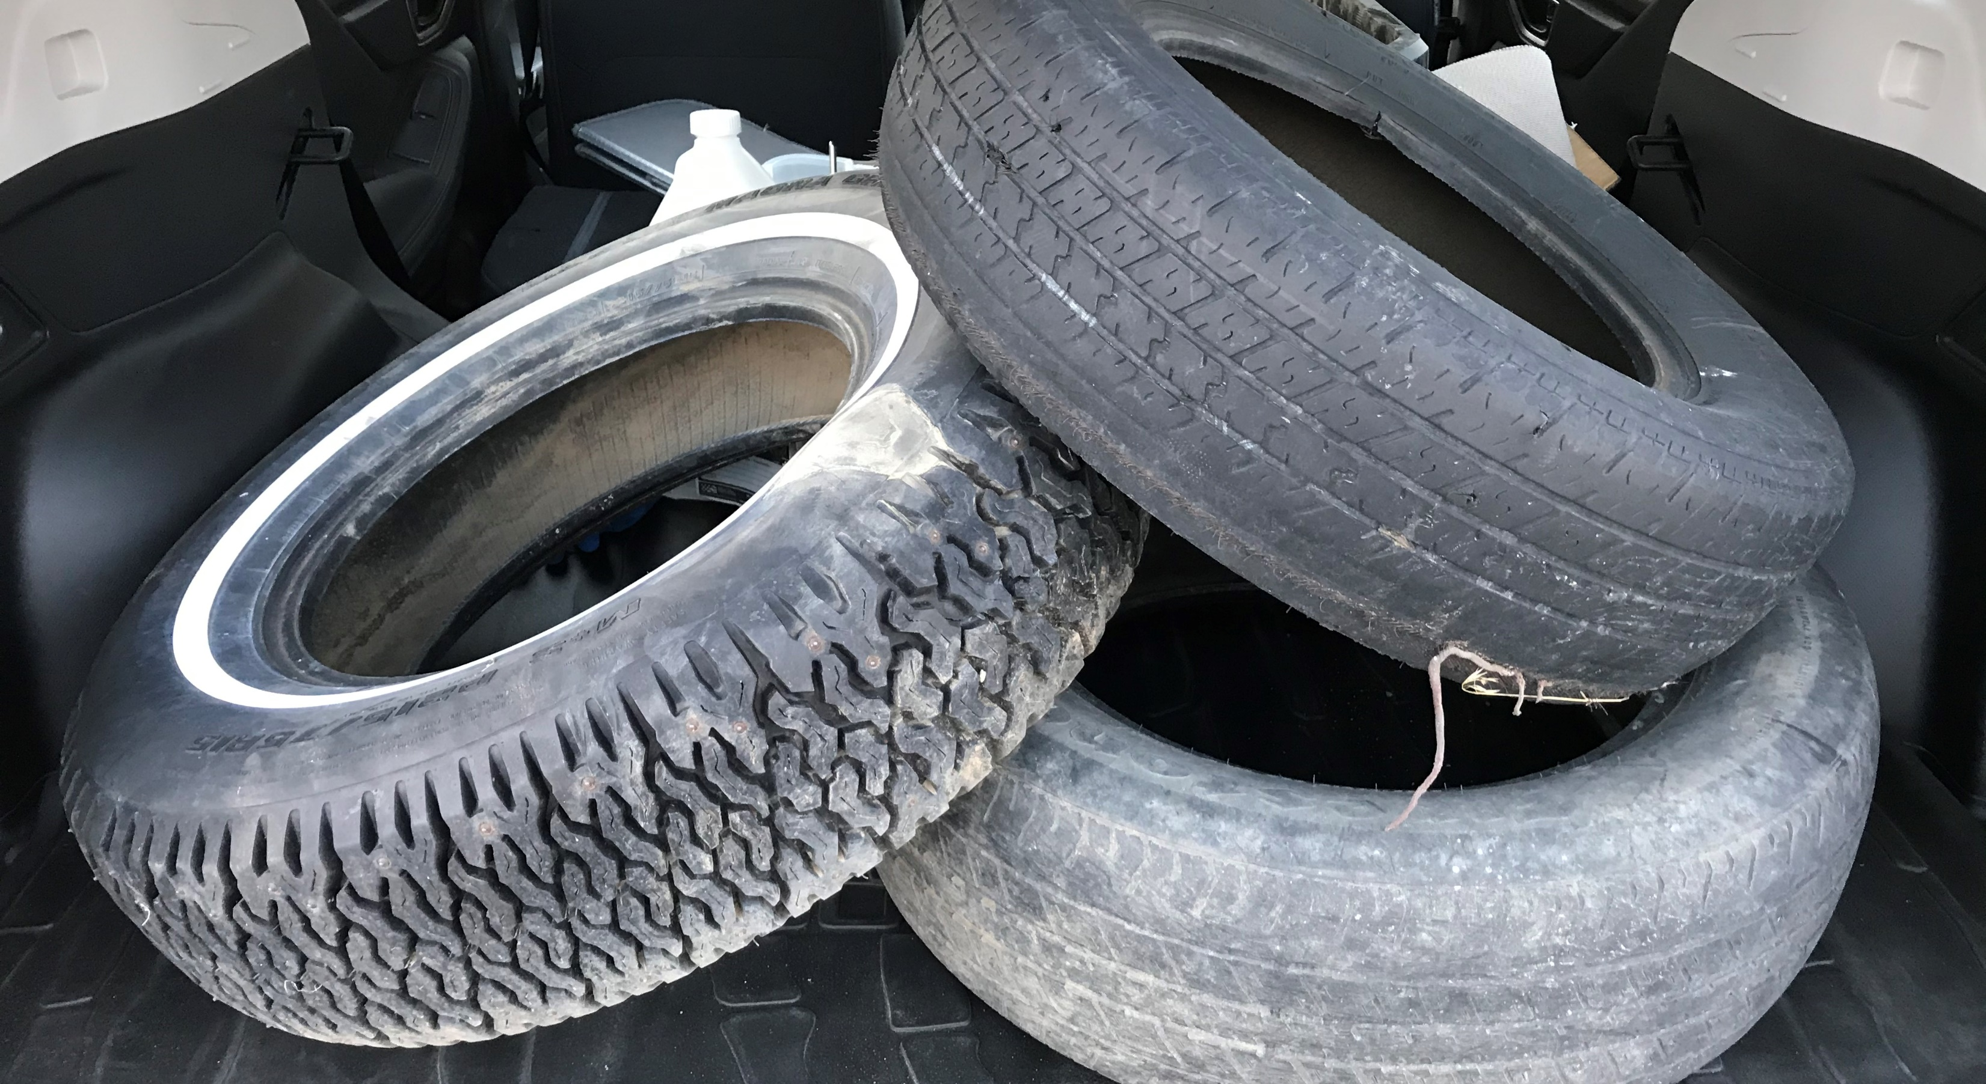
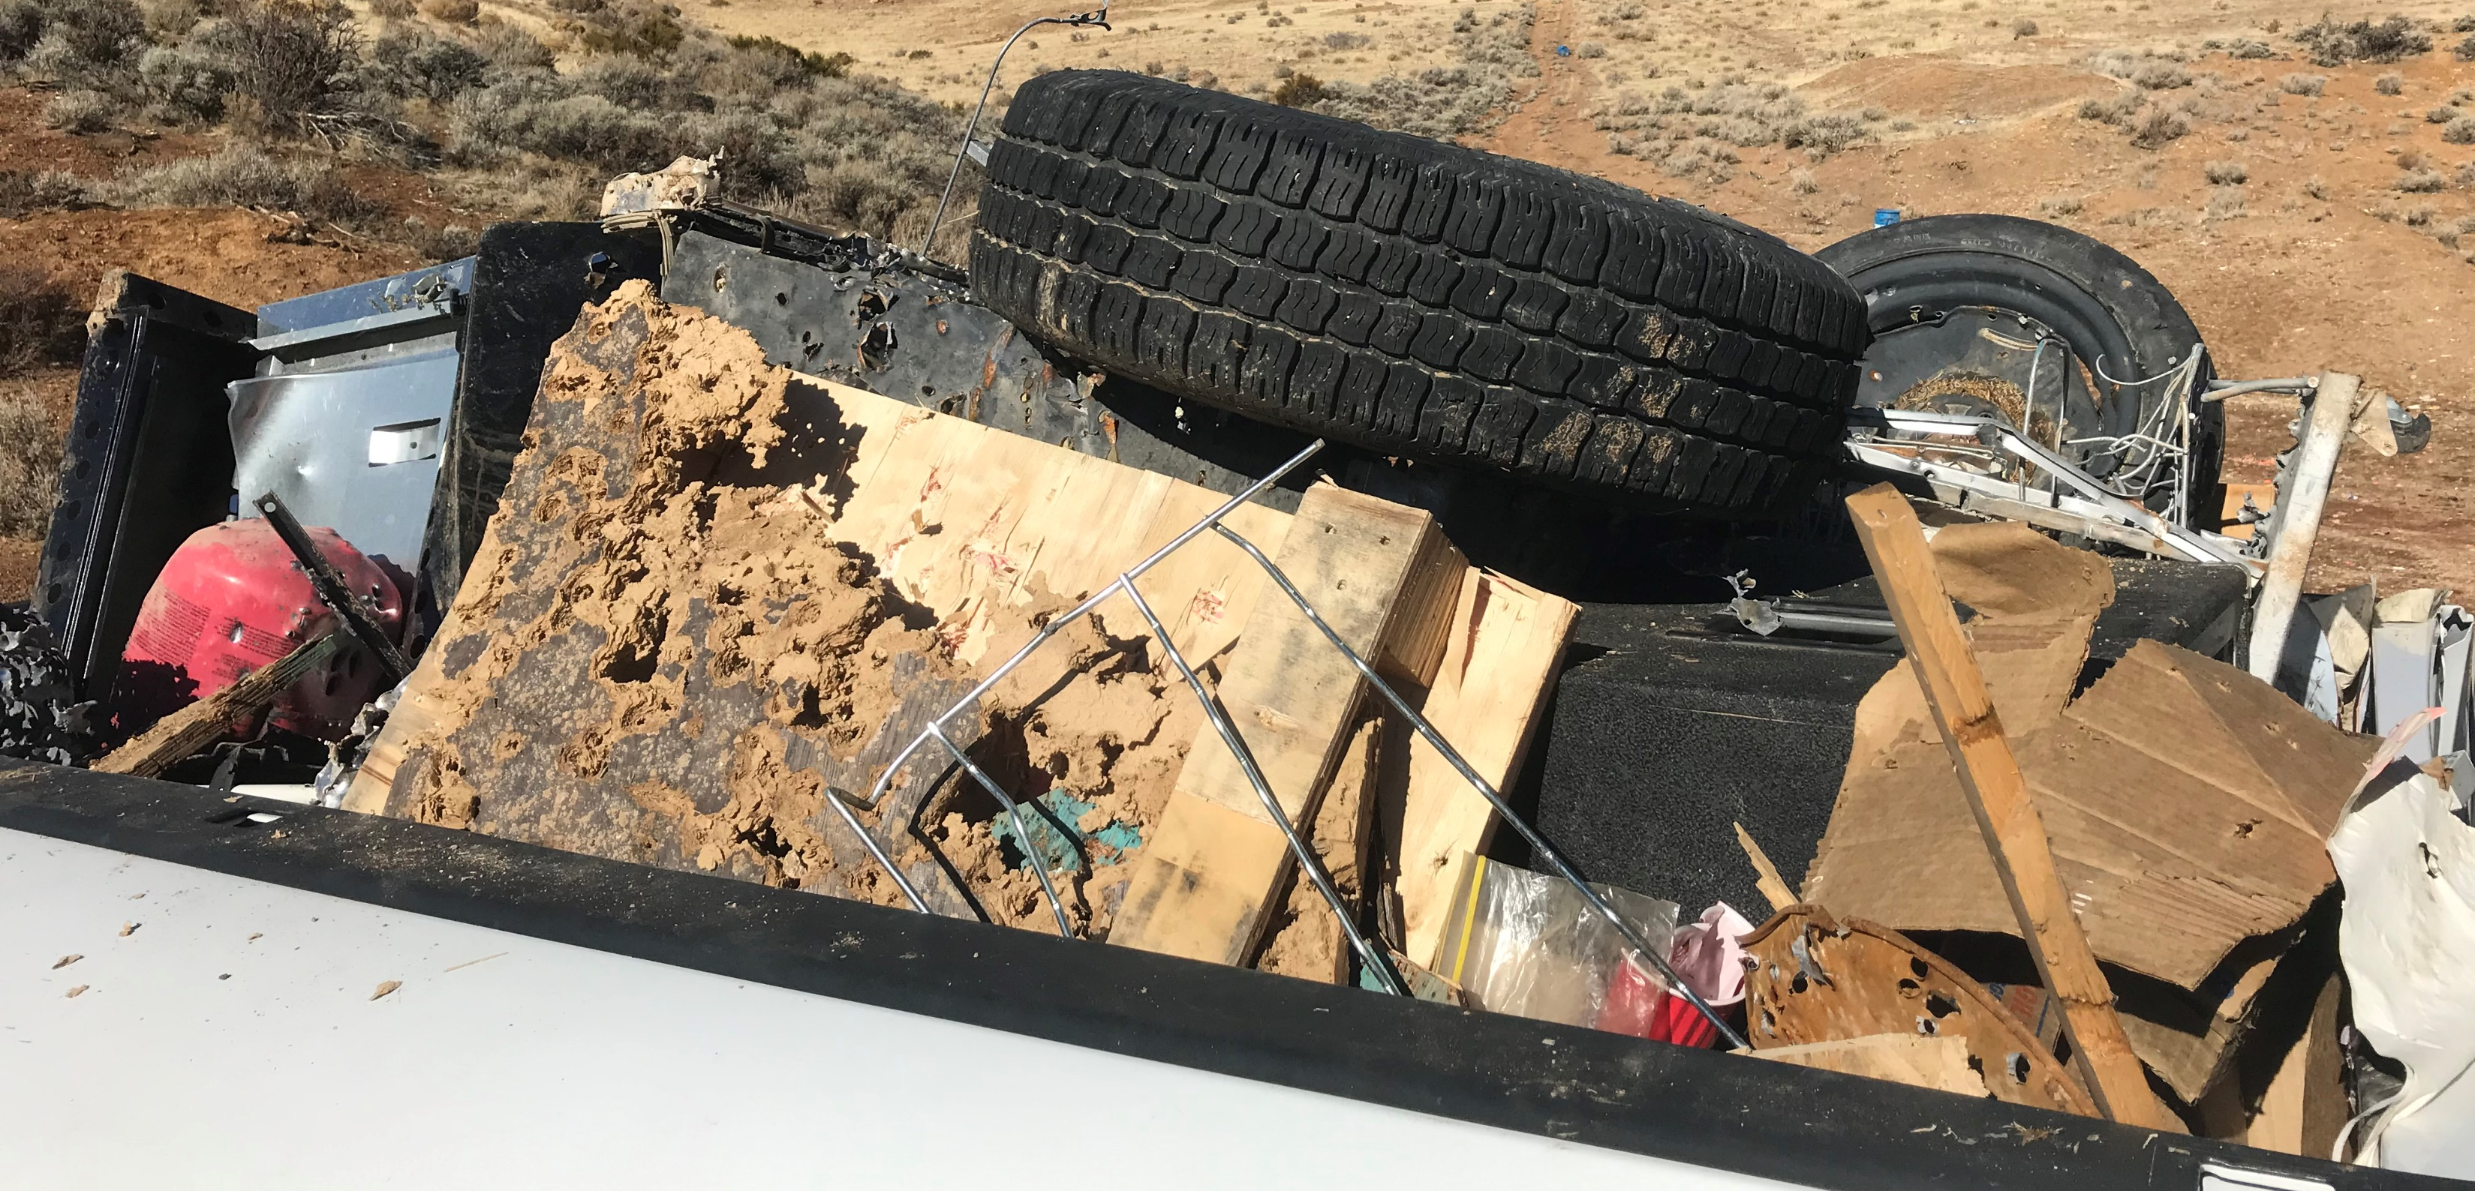
Desert Clean-Ups
Photos: John A. Duerk

Slide 20
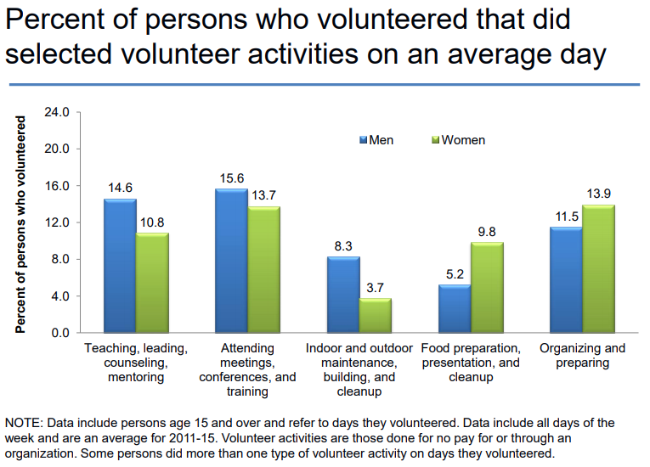
Source: Bureau of Labor Statistics

Slide 21
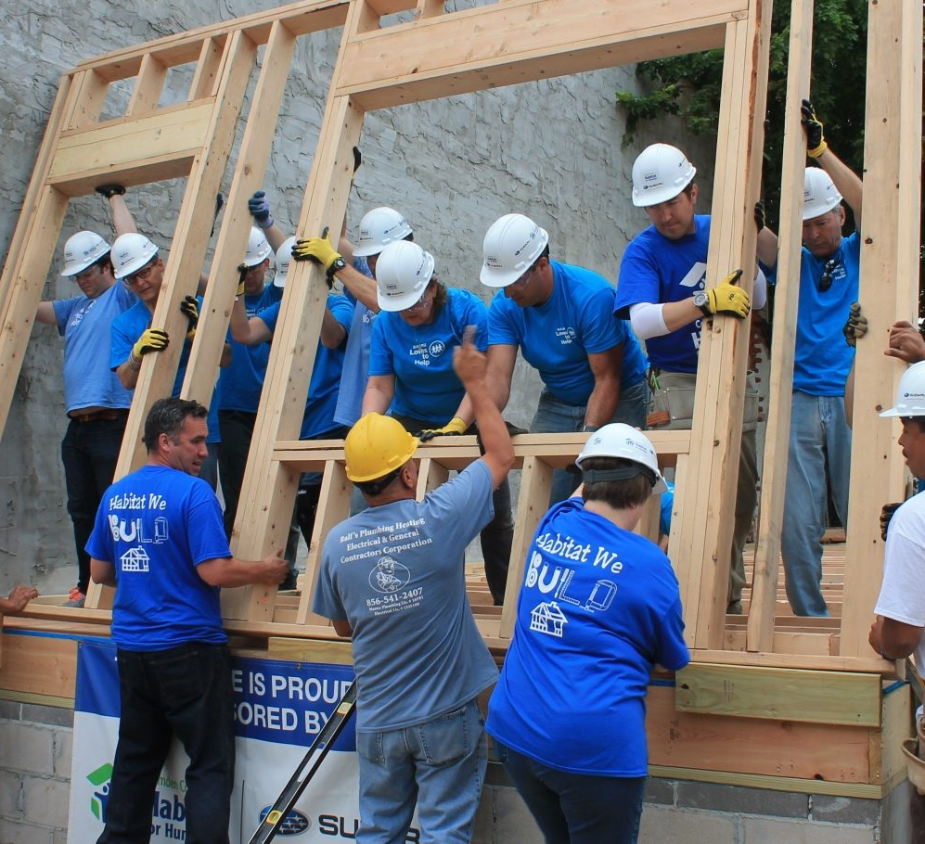
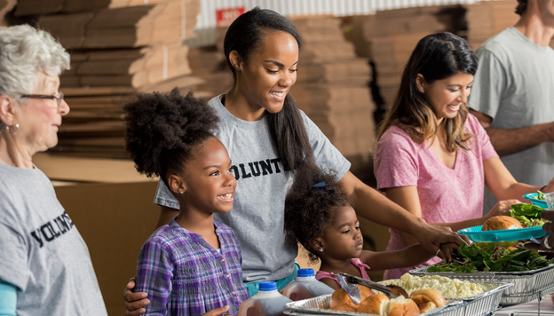
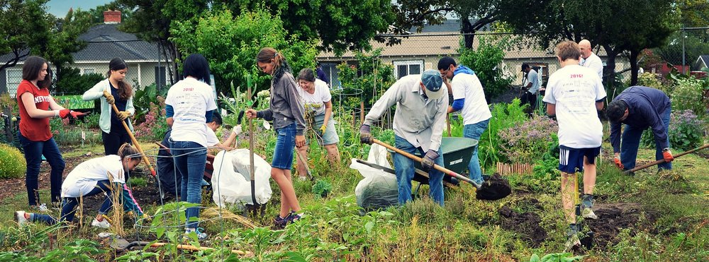
Source: Webster United Methodist
Source: Habitat for Humanity of Camden County
Source: Emerson Avenue Community Garden

Slide 22
Thought:
Nobody has time for every issue, but everybody can make the time for one issue.

Slide 23
Questions?

Slide 24
References
Bureau of Labor Statistics. (2015). Volunteer activities. https://www.bls.gov/tus/charts/volunteer.htm.
Dietz, N., Grimm, R., Ahmad, K. (2020, January 10). Philanthropy’s future in flux as volunteering and giving rates waver. Independent Sector. https://independentsector.org/news-post/philanthropys-future-in- flux-as-volunteering-and-giving-rates-waver/
Duerk, J. (2020, August 1). Illegal dumping must stop. Nevada Appeal. p. A16.
Keltner, D. (2016). The power paradox: How to gain and lose influence. Penguin Books.
Putnam, R. (2000). Bowling alone: The collapse and revival of American community. Simon & Schuster.
Putnam, R. & Garrett, S. R. (2020). The upswing: How America came together a century ago and how we can do it again. Simon & Schuster.
Vandermaas-Peeler, A., Cox, D., Fisch-Friedman, M., Griffin, R., Jones, R. P. (2018, July 17). American democracy in crisis: The challenges of voter knowledge, participation, and polarization. Public Religion Research Institute. https://www.prri.org/research/american-democracy-in-crisis-civic-engagement-young-adult- activism-and-the-2018-midterm-elections/

